Slide 1
Integrating with Data Sources
Essential concepts
Getting started with JPA
Defining an entity class
Managing entities
Using Spring Data repositories
Demo module: demo-spring-data

Slide 2
1. Essential Concepts
Spring vertical data access APIs
Spring Data project
Configuring Maven dependencies

Slide 3
Spring Vertical Data Access APIs
Spring provides vertical APIs for data access
Many technologies, including JDBC, JPA, Hibernate, etc.
Declarative transaction management
Transactional boundaries declared via configuration
Enforced by a Spring transaction manager
Automatic connection management
Acquires/releases connections automatically
3

Slide 4
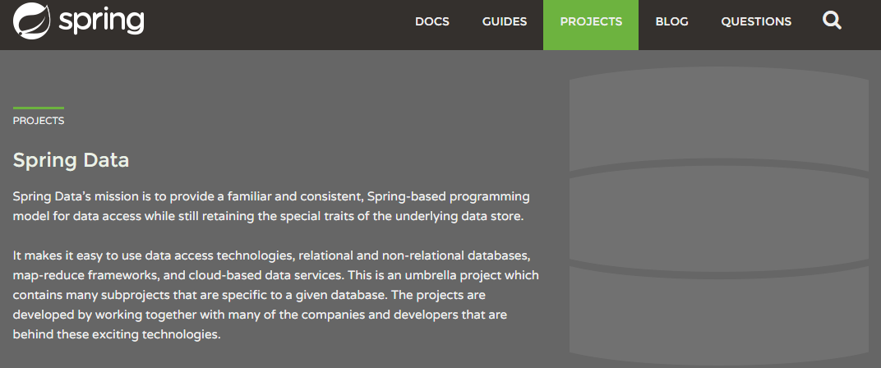
Spring Data Project
In recent times, the Spring Data project has emerged
Supports a wider range of data access technologies, including REST, RDBMS, NoSQL, elastic search, etc.
Powerful repository and object-mapping abstractions
Dynamic query creation from repository method names
4

Slide 5
Configuring Maven Dependencies
Add the appropriate Maven dependency for the type of data source you wish to access
We'll use an H2 in-memory database in our demos
Database is created/dropped when app starts/ends
Spring Boot does a lot of auto-configuration, based on the data sources it sees in your pom file (see later)
<dependency>
<groupId>com.h2database</groupId>
<artifactId>h2</artifactId>
<scope>runtime</scope>
</dependency>
pom.xml
5

Slide 6
2. Getting Started with JPA
Overview of JPA
Important JPA concepts
JPA dependency in Spring Boot
Spring Boot autoconfiguration
Customizing persistence properties
Demo package: demo.springdata.jpa

Slide 7
Overview of JPA
JPA = Java Persistence API
A standard ORM (object/relational mapping) API
JPA is a specification
Implemented by the Hibernate library
Also implemented by Java Enterprise Edition
To use JPA in Spring:
Add the Hibernate library to your classpath (see later)
7

Slide 8
Important JPA Concepts
Entity class - maps a class to a db table
Entity objects correspond to rows in the db table
Entity manager - enables you to fetch entities from db
Also automatically flushes modified entities to the db
Entity manager factory - creates an entity manager
Configures the entity manager so it can connect to a db
8

Slide 9
JPA Dependency in Spring Boot
To use JPA in a Spring Boot app, you need to add the following dependency to your pom file:
<dependency>
<groupId>org.springframework.boot</groupId>
<artifactId>spring-boot-starter-data-jpa</artifactId>
</dependency>
pom.xml
9

Slide 10
Spring Boot Autoconfiguration
Courtesy of the JPA dependency, Spring Boot creates several beans automatically in your application
JdbcTemplate
Handy wrapper API for JDBC
H2 db
EntityManagerFactory
Creates EntityManager
DataSource Gets connections to database
PlatformTransactionManager
Starts/ends transactions
10

Slide 11
Customizing Persistence Properties
Spring Boot automatically sets persistence properties to connect to the in-memory H2 database:
You can customize persistence properties if you need to
spring.datasource.url=jdbc:h2:mem:example
spring.datasource.username=sa
spring.datasource.password=
spring.jpa.database-platform=org.hibernate.dialect.H2Dialect
spring.jpa.hibernate.ddl-auto=create-drop
spring.jpa.properties.hibernate.show_sql=true
spring.jpa.properties.hibernate.use_sql_comments=true
spring.jpa.properties.hibernate.format_sql=true
application.properties
11

Slide 12
3. Defining an Entity Class
How to define an entity class
Locating entity classes
Seeding the database with data
Viewing the database data

Slide 13
How to Define an Entity Class
You can define an entity class as follows:
import javax.persistence.*;
@Entity
@Table(name="EMPLOYEES")
public class Employee {
@Id
@GeneratedValue(strategy = GenerationType.IDENTITY)
private long employeeId = -1;
private String name;
private String region;
@Column(name="salary")
private double dosh;
// Plus constructors, getters/setters, equals(), hashCode(), and toString()
}
Employee.java
13

Slide 14
Locating Entity Classes
A Spring Boot app scans for entity classes when it starts
It looks in the main app class package, plus sub-packages
You can tell it to look elsewhere, if you like
Via @EntityScan
@SpringBootApplication
@EntityScan( {"myentitypackage1", "myentitypackage2"} )
public class Application {
…
}
14

Slide 15
Seeding the Database with Data
For convenience during development/testing, you can seed the database with some sample data
import org.springframework.jdbc.core.JdbcTemplate;
…
@Component
public class SeedDb {
@Autowired
JdbcTemplate jdbcTemplate;
@PostConstruct
public void init() {
jdbcTemplate.update("insert into EMPLOYEES(name,salary,region) values(?,?,?)",
new Object[]{"James", 21000, "London"});
…
}
}
SeedDb.java
15

Slide 16
Viewing the Database Data (1 of 3)
Most databases have a console UI, to let you view data
To enable the H2 console UI, add these app properties:
The H2 console UI is a web endpoint, so you must also add the Spring Boot web dependency to your pom:
spring.h2.console.enabled=true
spring.h2.console.path=/h2-console
application.properties
<dependency>
<groupId>org.springframework.boot</groupId>
<artifactId>spring-boot-starter-web</artifactId>
</dependency>
pom.xml
16

Slide 17
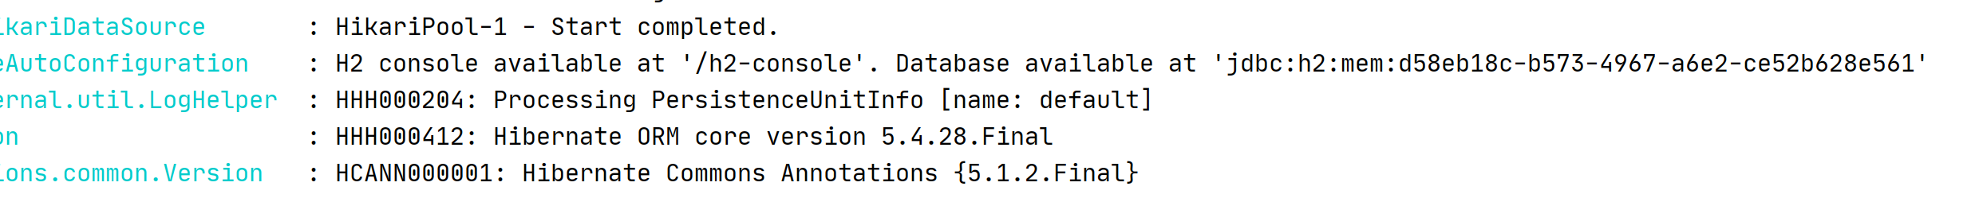
Viewing the Database Data (2 of 3)
When you run your app, you'll see a message that indicates the connection URL for the database
You can use this URL to connect to the database in the H2 console UI - see next slide
17

Slide 18
Viewing the Database Data (3 of 3)
To open the H2 console UI, browse to:
http://localhost:8080/h2-console
To connect to the database, enter these details:
JDBC URL - as per previous slide
User name - sa
Password - leave blank
You can then view tables etc. in the database - cool!
18

Slide 19
4. Managing Entities
Defining a repository class
Performing a simple query
Finding an entity by primary key
Getting a list of entities
Performing data modification operations

Slide 20
Defining a Repository Class
In the demo, we put our JPA code in a repository class
We use an injected EntityManager to do the work
import javax.persistence.*;
…
@Repository
public class EmployeeRepository {
@PersistenceContext
protected EntityManager entityManager;
// Methods to create, read, update, and delete database records.
// See following slides for details…
}
EmployeeRepository.java
20

Slide 21
Performing a Simple Query
Define a query string
Using JPQL (or SQL)
Create a TypedQuery<T> object
Via createQuery() on the EntityManager
Execute the query, and get a single result back
Via getSingleResult() on the query object
public long getEmployeeCount() {
String jpql = "select count(e) from Employee e";
TypedQuery<Long> query = entityManager.createQuery(jpql, Long.class);
return query.getSingleResult();
}
EmployeeRepository.java
21

Slide 22
Finding an Entity by Primary Key
To find an entity by primary key:
Call find() on the EntityManager
Returns null if entity not found
public Employee getEmployee(long employeeId) {
return entityManager.find(Employee.class, employeeId);
}
EmployeeRepository.java
22

Slide 23
Getting a List of Entities
To get a list of entities:
Call getResultList() on a query object
public List<Employee> getEmployees() {
String jpql = "select e from Employee e";
TypedQuery<Employee> query = entityManager.createQuery(jpql, Employee.class);
return query.getResultList();
}
EmployeeRepository.java
23

Slide 24
Performing Data Modification Operations
This is how you insert, update, and delete entities using JPA - also note the need for @Transactional
@Transactional
public void insertEmployee(Employee e) {
entityManager.persist(e);
}
@Transactional
public void updateEmployee(Employee e) {
Employee entity = entityManager.find(Employee.class, e.getEmployeeId());
entity.setName(e.getName());
entity.setDosh(e.getDosh());
entity.setRegion(e.getRegion());
}
@Transactional
public void deleteEmployee(long employeeId) {
Employee e = entityManager.find(Employee.class, employeeId);
entityManager.remove(e);
}
EmployeeRepository.java
24

Slide 25
5. Using Spring Data Repositories
Overview
Spring Data repository capabilities
Domain-specific repositories
Locating Spring Data repositories
Using Spring Data repositories
Demo package: demo.springdata.repos

Slide 26
Overview
Spring Data is a data-access abstraction mechanism
Makes it very easy to access a wide range of data stores
Using a familiar "repository" pattern
It provides template repositories for…
JPA
MongoDB, Cassandra, Neo4J, DynamoDB, etc.
Etc.
26

Slide 27
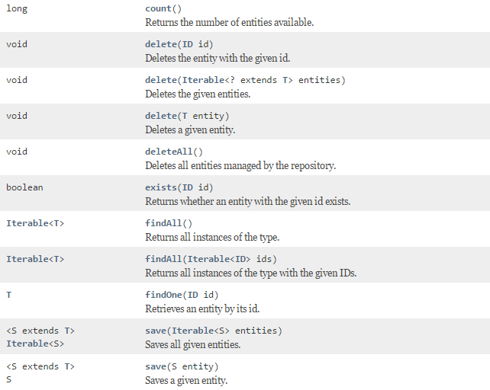
Spring Data Repository Capabilities
Spring Data defines agnostic data-access repository interfaces, e.g. CrudRepository
27

Slide 28
Domain-Specific Repositories (1 of 2)
You can define your own domain-specific interfaces
Extend CrudRepository
Specify the entity type and the PK type
You can define specific query methods for your entities
Spring Data reflects on method names to create queries
You can provide explicit JPQL syntax for complex queries
For details about Spring Data repositories, see:
https://docs.spring.io/spring-data/data-commons/docs/2.4.x/reference/html/#repositories
28

Slide 29
Domain-Specific Repositories (2 of 2)
Here's an example of a domain-specific repository
Entity type is Employee, PK type is Long
Also we've defined some additional queries
public interface EmployeeRepository extends CrudRepository<Employee, Long> {
List<Employee> findEmployeesByRegion(String region);
@Query("select emp from Employee emp where emp.dosh >= ?1 and emp.dosh <= ?2")
List<Employee> findEmployeesInSalaryRange(double from, double to);
Page<Employee> findEmployeesByDoshGreaterThan(double salary, Pageable pageable);
}
EmployeeRepository.java
29

Slide 30
Locating Spring Data Repositories
A Spring Boot app scans for Spring Data JPA repository interfaces when it starts
It looks in the main app class package, plus subpackages
You can tell it to look elsewhere, if you like
Via @EnableJpaRepositories
import org.springframework.data.jpa.repository.config.EnableJpaRepositories;
…
@SpringBootApplication
@EnableJpaRepositories({"repopackage1", "repopackage2"})
public class Application {
…
}
30

Slide 31
Using Spring Data Repositories
@Component
public class EmployeeService {
@Autowired
private EmployeeRepository repository;
public void doDemo() {
// Insert an employee.
Employee newEmp = new Employee(-1, "Simon Peter", 10000, "Israel");
repository.save(newEmp);
System.out.printf("There are now %d employees\n", repository.count());
// Get all employees.
displayEmployees("All employees after insert: ", repository.findAll());
// Get employees by salary range.
List<Employee> emps = repository.findEmployeesInSalaryRange(20000, 50000);
displayEmployees("Employees earning 20k to 50k: ", emps);
// Get a page of employees.
Pageable pageable = PageRequest.of(1, 3, Direction.DESC, "dosh");
Page<Employee> page = repository.findEmployeesByDoshGreaterThan(50000, pageable);
displayEmployees("Page 1 of employees more than 50k: ", page.getContent());
}
…
EmployeeService.java
31

Slide 32
Summary
Essential concepts
Getting started with JPA
Defining an entity class
Managing entities
Using Spring Data repositories

